Slide 1
Introduction to Discrete Structures II Lecture 1
John P. Baugh, Ph.D. University of Michigan - Dearborn

Slide 2
Why more Discrete Structures?
CIS 275 (Discrete Structures I) should have covered the fundamentals of discrete mathematics used in computer science and related theory
Set theory
Formal logic
Graphs
Number theory
Combinatorics (counting theory)
Functions and Relations
Trees
Etc.

Slide 3
Why more Discrete Structures?
CIS 306 will focus largely on the following major subject areas
Computation modeling
Producing abstract models of computing devices
Determining what is (and what isn’t) computable or decidable
Determining what we can solve in a reasonable amount of time
More specific areas
Further number theoretic primitives used in cryptography, such as in the RSA cryptosystem
Game theory
Computational geometry

Slide 4
Nature of Computation
Different fields have different ways of knowing something
Mathematics – proofs are given
Natural sciences and engineering – prefer a proof that something works
Testable
Reproducibility
Social sciences
Statistically correct

Slide 5
Modeling computation
In general, models are generally used to capture ideas
Often, they are simplified
For modeling of systems in motion, components might be slowed down or frozen
More specifically, models of computation are models that provide information about the relationships between input and output
How did we arrive at certain output from given input?
Models of computation can be studied for efficiency (computational complexity) independent of a particular implementation
I.e., Big O as opposed to runtime analysis
The models of a computer are much simpler than an actual computer, and therefore much easier to analyze
Each new model gives us new methods of solving real world problems
Sometimes, we discover new paradigms for tackling problems

Slide 6
Modeling computation
In computer science, we have many different areas we pull from and use to model computation, and to help us describe and devise new algorithms and techniques
Grammar (Noam Chomsky)
Mathematics and Statistics
Nature
Simulated annealing
Neural networks
Evolutionary computing

Slide 7
Frustrations with computers
Brittle
Non-adaptive
Don’t learn the way we do
Don’t deal well with heavily corrupted data

Slide 8
Natural Computation
Nature-inspired computation – one area of modeling

Slide 9
Natural computation
Evolutionary computation
Neural computation
Molecular computation
Quantum computation
Ecological computation
Biological computation
…

Slide 10
Genetic Algorithms
Ideas:
Genetic algorithms are a type of evolutionary algorithm
The population consists of potential solutions to a problem
“Natural” selection is applied to the population, killing out bad (unfit) solutions, and letting the good solutions survive
Small random changes (“mutations”), as well as crossover are made to the next generations of good solutions
Algorithms generally consist of the following:
Initialize a population
Repeat until the halting criteria are met:
Evaluate fitness of individual solutions in the population
Parent selection (natural selection)
Breeding/reproduction by crossover and mutation to generate new generation

Slide 11
Example of Genetic Algorithms
https://www.youtube.com/watch?v=qiKW1qX97qA
Beta Brook – travelling salesman solved by genetic algorithms

Slide 12
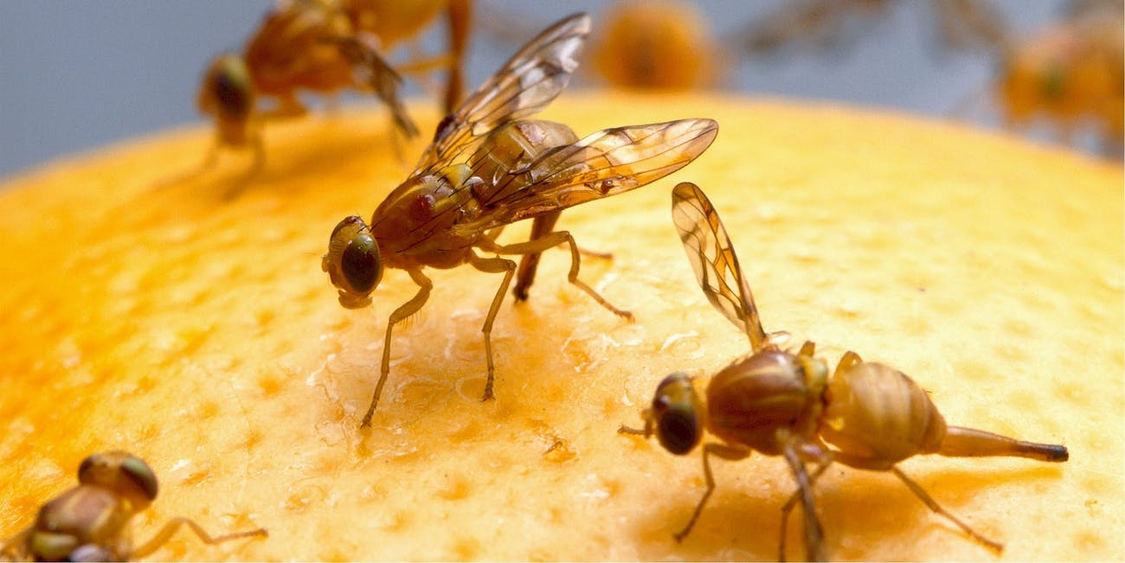
From Fruit Flies to Cell Phone Channels
Based on the work of Dr. Alberto Moraglio at Exeter University in the U.K.
https://emps.exeter.ac.uk/computer-science/staff/am666

Slide 13
From Fruit Flies to Cell Phone Channels
Frequency assignment in mobile phone networks is very difficult
There are many more device users than there are channels available
How do we allocate different channels to different users?
We clearly have to reuse the channels
Problems?
Users might end up with the same channel, and if communication occurs over the same channel, there is network interference (noise) which corrupts the cellular data
Users might have adjacent channels, which might cause some interference as well

Slide 14

From Fruit Flies to Cell Phone Channels
In a network with j base stations and k available channels, the number of different ways of allocating c channels to each base station is:
$${\left(\frac{k!}{(\left(k−c\right)!)(c!)}\right)}^{j}$$
Therefore, for example:
Clearly, exhaustive search to find optimal configuration is not feasible!
j | k | c | Number of solutions
3 | 5 | 1 | 125
5 | 10 | 5 | 1016255020032
10 | 10 | 3 | 61917364240000000000
58 | 29 | 4 | 6 * 10²⁵³

Slide 15
From Fruit Flies to Cell Phone Channels
Fruitflies (Drosophola melanogaster) have an insensitive exoskeleton peppered with sensors formed from short bristles attached to nerve cells
It is important that the bristles are more or less evenly spread out across the surface of the fly
In particular it is undesirable to have two bristles right next to each other
The correct pattern is formed during the fly's development by interactions among its cells
The individual cells "argue" with each other by secreting protein signals, and perceiving the signals of their neighbors.
The cells are autonomous, each running its own "algorithm" using information from its local environment.
Each cell sends a signal to its neighbors; at the same time it listens for such a signal from its neighbors.
The signal is saying, in effect, "I want to make a bristle“
The more "loudly" it "hears" its neighbors signaling, the less of the signal it produces
In other words the signal is inhibitory
This "arguing" process is the inspiration for the channel allocation method (a.k.a. flyphone)

Slide 16
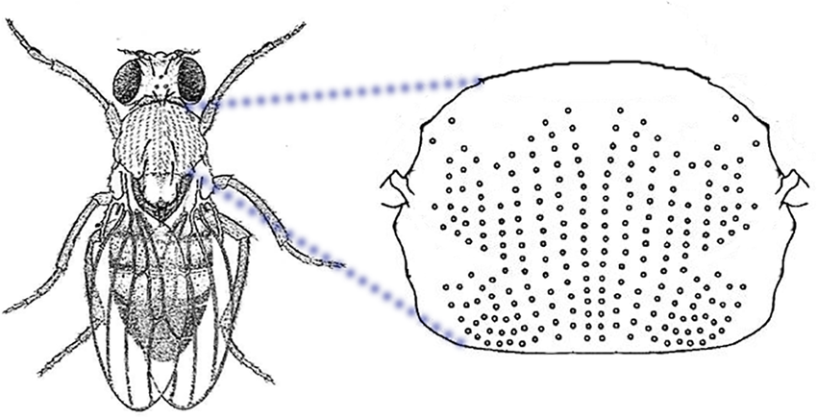
From Fruit Flies to Cell Phones

Slide 17
Other examples
Artificial life
Boids (https://www.red3d.com/cwr/boids/)
https://www.youtube.com/watch?v=QbUPfMXXQIY for an example/simulation
Karl Sim’s artificial creatures (https://www.youtube.com/watch?v=JBgG_VSP7f8 – 1994)
Neural computation
Evolutionary art

Slide 18
History
The Giants Upon Whose Shoulders We Stand

Slide 19
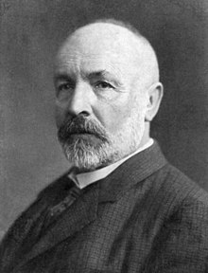
Georg Cantor (1845-1918)
Invented set theory
Found many paradoxes in mathematics
Had some unusual ideas
Infinity comes in different sizes
E.g., # of real numbers vs # of integers
Discovered sets bigger than the universal set

Slide 20
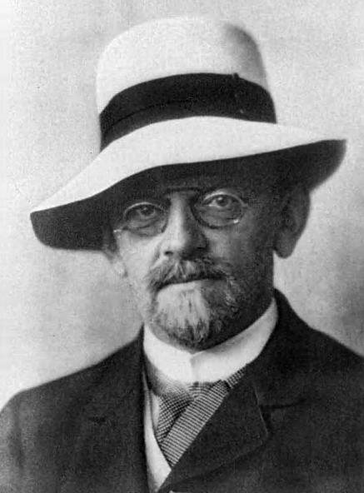
David Hilbert (1862 – 1943)
Wanted to make all mathematics as rigorous as Euclidean Geometry
I.e., he wanted to include definitions, axioms, theorems, proofs, algorithms
Wanted to be able to prove all things are either true or false
Wanted a methodology for proving things so that even people without imaginations could do proofs

Slide 21
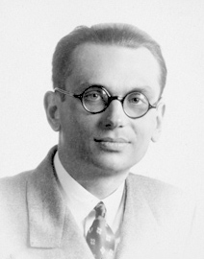
Kurt Gödel (1906 – 1978)
Proved that not all true things can be proven true
Proved that either there are false things that can be proven true (false positive) or else, not all true things can be proven true
Known as the Incompleteness theorem
Wanted to be able to prove true all things that could be proven true
Generated models of computation

Slide 22
Others
Church, Kleene, Post, Marko, von Neumann and Turing all worked on creating simple building blocks to create algorithms
Turing went further and proved that there exist problems that the machine itself cannot answer

Slide 23
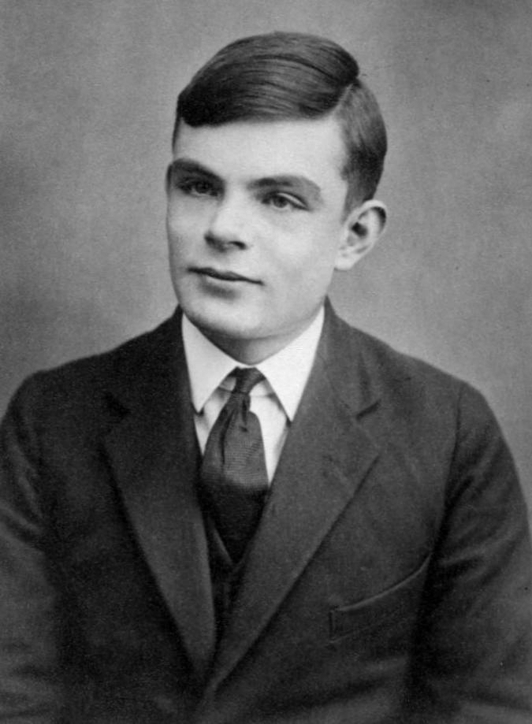
Alan Turing (1912 – 1954)
Considered by many to be the father of modern computer science
Provided influential formalization of the concept of the algorithm and computation with the Turing machine
With the Turing test
Made significant and characteristically provocative contribution to the debate regarding artificial intelligence
Major step toward answering, “Will a machine ever be able to be considered conscious and/or be able to actually think?”

Slide 24
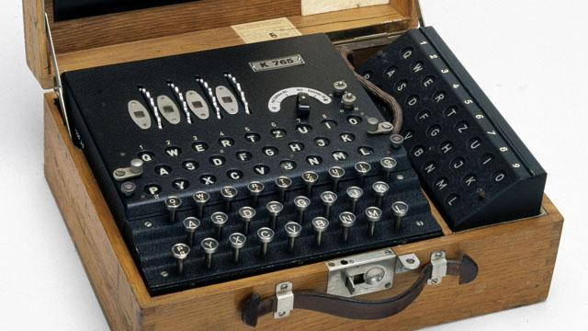
Enigma Machine
During WWII, Turing was primarily responsible for cracking the German Enigma code using sophisticated cryptanalysis techniques
He primarily chose the Enigma problem because no one else had success and he, quote, “…could have it all to myself…”

Slide 25
Where are we now?
We are now in a time of unprecedented innovation
Even greater than the “Internet revolution” of the 90s
Data context
A 500 page book can be considered about 1 MB
Entire human genome is about 1 GB
Follow a human around for 70-80 years and capture their life experiences on a camcorder – about 1 TB
If you took 700 billion trees from the Amazon, turned them all into paper and wrote letters on both sides, that’s about 1 Petabyte (1 PB)

Slide 26
Where are we now?
We have more data at our disposal than ever before
From the beginning of human history until 2005, humans had created approximately 130 Exabytes of data (130,000 Petabytes or 130 million Terabytes)
By 2010, this number was 1,200 Exabytes
By 2015, this number was 7,900 Exabytes
By 2020, it’s expected that we will have produced 40,900 Exabytes
With these massive and complex numbers, it’s no surprise that so many areas of computer science (such as data science and artificial intelligence) are booming
The ability to model and create abstractions, descriptions, and analyses are crucial tools in the toolbox of any computer scientist, software engineer, or data scientist

Slide 27
Foundations for the Future
Can you be a computer scientist without this course?
Yes. But you will have missed out on extremely important information
Besides direct application, the topics will help you expand your ability to describe and solve problems and their solutions
Much artificial intelligence depends on some understanding of computational models
AI is expected to generate 2.3 million new jobs by 2020
Data-driven investments and those utilizing AI have hit over $1 trillion in 2018

Slide 28
Questions?
Questions?
Comments?
Remarks?

